Slide 1
Review
Correlation!!!

Slide 2
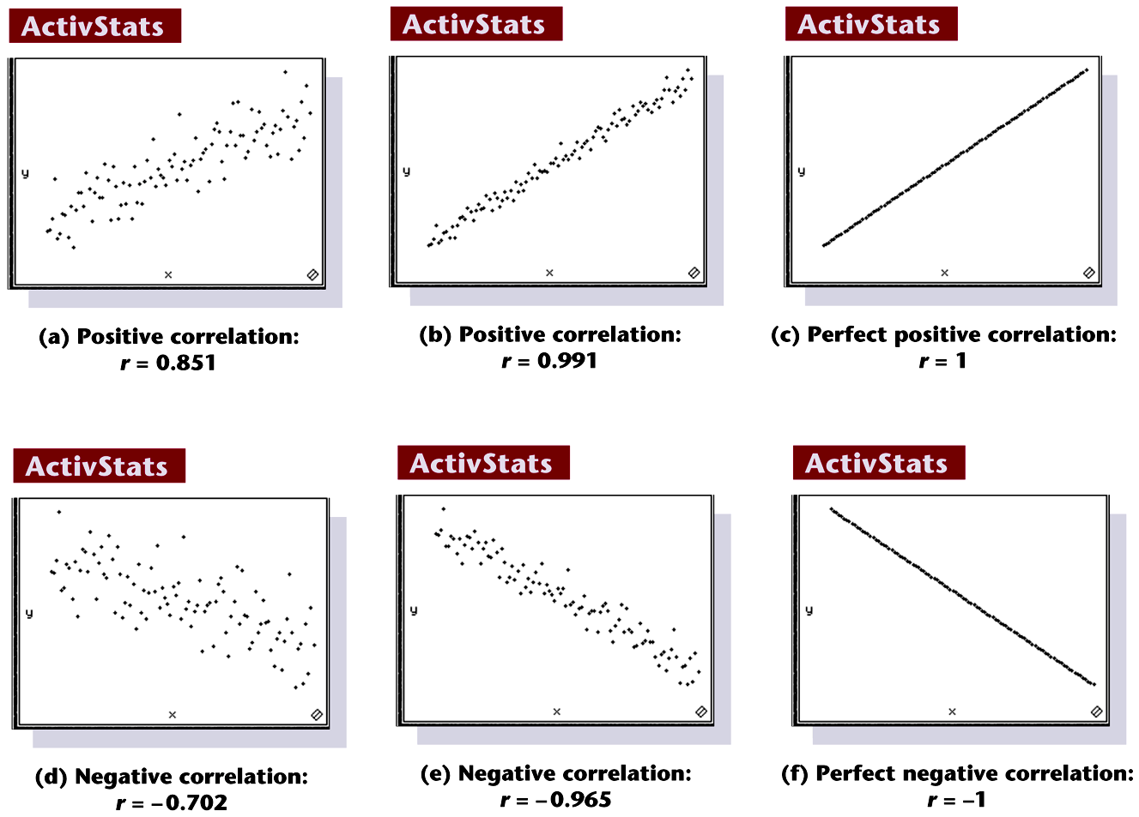
Scatterplots of Paired Data
Notes:
Page 619 of text

Slide 3
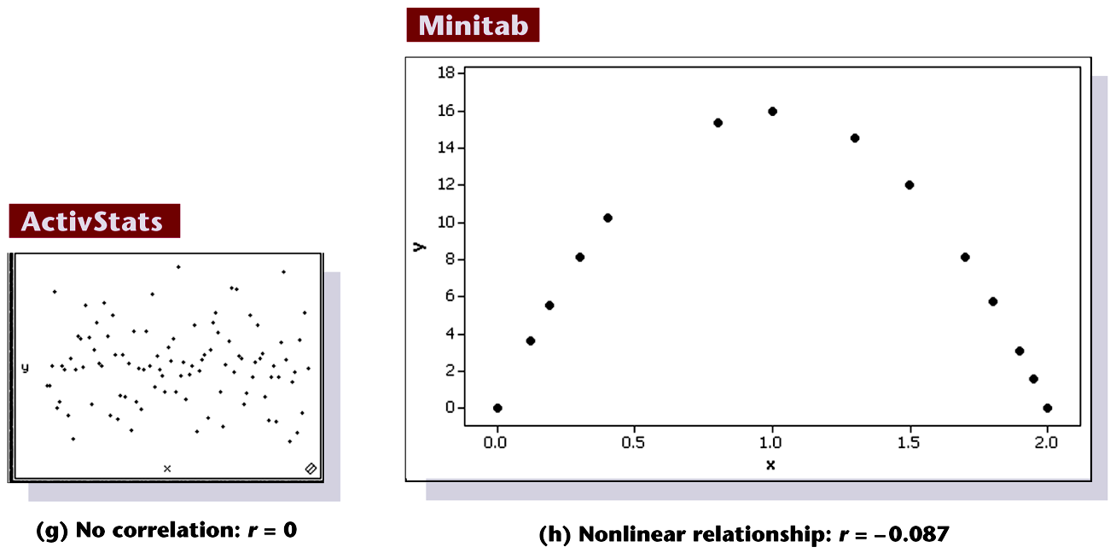
Scatterplots of Paired Data
Notes:
Page 619 of text

Slide 4
Simple Linear Regression!!!

Slide 5
Last time we considered ….
Example :
Studying Hours and Grades!

Slide 6
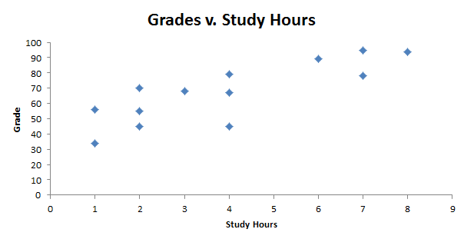
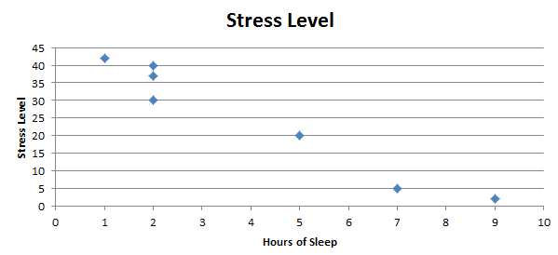
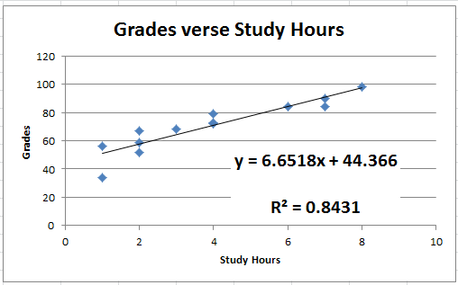
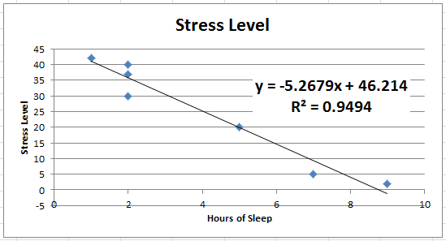
Grades v. Study Hours
A
B

Slide 7
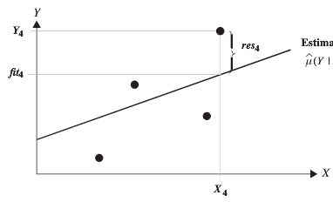
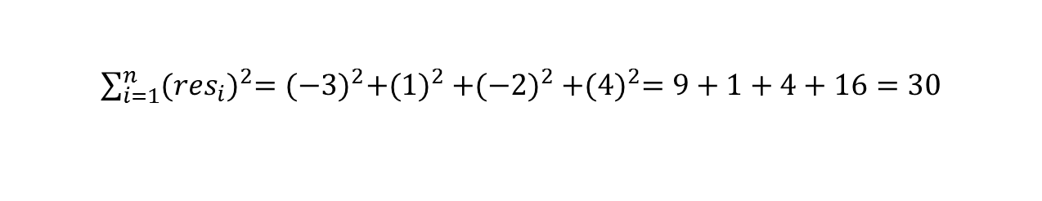
How to find the “Best” Line
Residuals: res = observed - predicted
res₄ = 4
res₂ = 1
res₃ = -2
res₁ = -3
Notice if we simply add the residuals we will get zero!
This is why we will square each residual and then sum them together.
Sum of Squared Residuals = SSR =

Slide 8
Grades v. Study Hours
res₁₀ = 3
res₁₃= .5
res₈ = 7
res₆ = 60
res₉ = -2
res₁₀ = 40
res₃ = 6
res₄ = .2
res₆ = 5
res₈ = 55
res₉ = 35
res₁ = 1
res₅ = -1
res₇ = -6
res₁₃ = 30
res₃ = 80
res₂= -10
res₇ = 20
res₁ = 50
res₅ = 60
The squared and summed green residuals will be greater than the squared and summed red residuals.
res₄ = 20
res₂ = 30

Slide 9
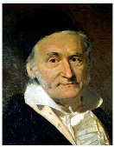
Least Squares Regression Line
The “Least Squares Line minimizes the sum of squared residuals!

Slide 10
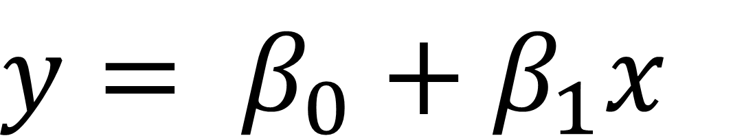
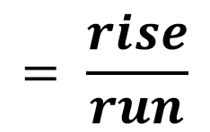
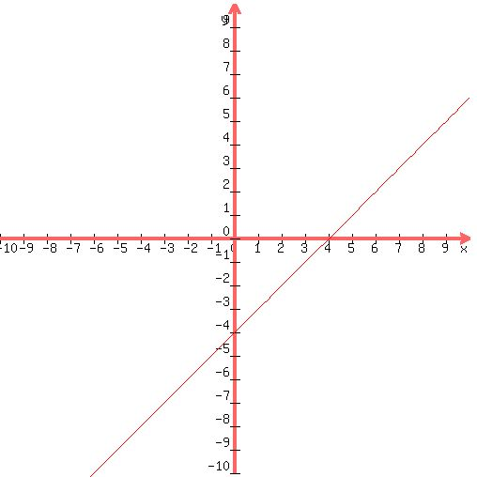



Equation of a Line!!!
y = mx + b

Slide 11
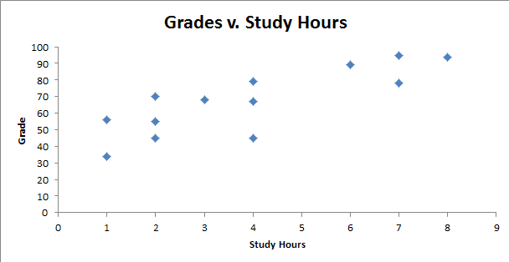
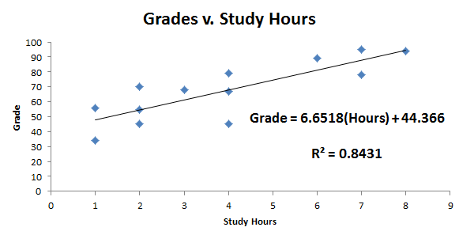
Grades v. Study Hours
We can use the regression line to predict a grade given the number of hours studied.
The predicted grade for a student who studied four hours would be:
Grade = 6.6518(4 hours) + 44.366 = 70.97 points
Try one! Given this data, predict the Grade a student who studied 7 hours would receive.
Grade = 6.6518(7 hours) + 44.366 = 90.93 points

Slide 12
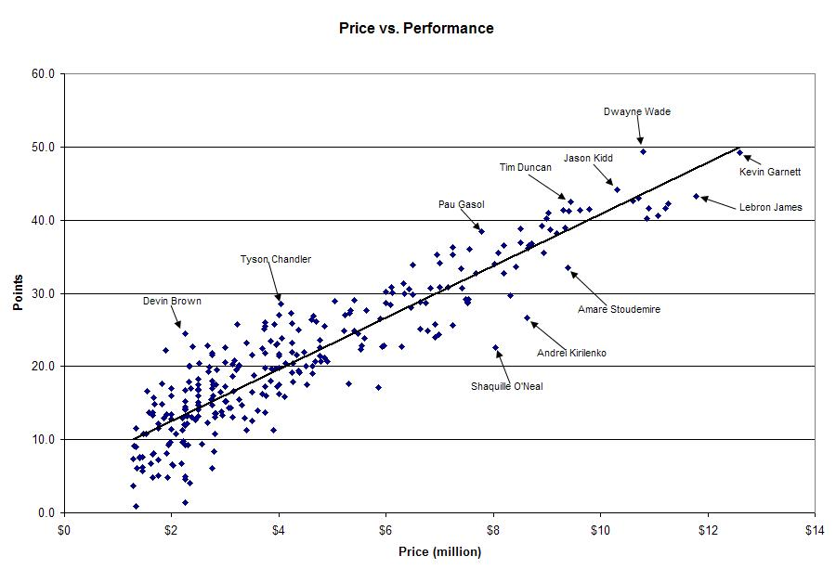
r = .907
r² = 0. 823
^
Points = 6 + 3(Price)
Give it a shot! (No pun intended!) ….
What is the best predicted points per game for a player who is paid $9.5 million?
Points = 6 + 3 * 9.5 = 34.5 points per game!

Slide 13
Extrapolation!
The prediction are only valid for values of x inside of the domain of x that were used to build the model.
That is, for the Grade v. Study Hours data set, the regression equation is only valid for study hours as small as 1 and as large as 8 hours.
Any prediction outside of the domain of x that was used to build the model is known as extrapolation.

Slide 14
Extrapolation: Example
^
Given this data, predict the Grade a student who studied 18 hours would receive.
Grade = 6.6518(18 hours) + 44.366 = 164.1points
Clearly this is impossible … but we have extrapolated.

Slide 15
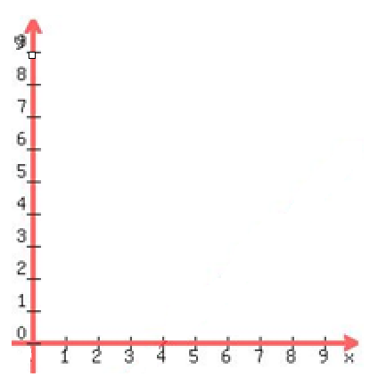




Interpretation: Slope and Y – Intercept
$β_{1}=slope=\frac{rise}{run}=\frac{2}{1}$
$$∆y= 2$$
$$∆x=1$$
$β_{0}=$Y-int = 1.5
Slope Interpretation: A 1 unit increase in x results in a 2 unit increase in predicted y.
Y-int Interpretation: The predicted response that corresponds to x = 0 is 1.5.

Slide 16
Grades v. Study Hours
Interpret the slope ….
Each extra hour spent studying results in a 6.6518 point increase in the predicted grade.
Interpret the y – intercept
The predicted grade for a student who studies no hours is 44.37 points.

Slide 17
r = .907
r² = 0. 823
^
Points = 6 + 3(Price)
Slope Interpretation: Each $1 million increase in the price results in a 3 point increase in predicted point production per game.
Y-Intercept interpretation: A player who is not paid is still predicted to have 6 points per game on average. Why doesn’t this make sense?. EXTRAPOLATION

Slide 18
Steps in Performing Linear Regression
Before you do anything … PLOT THE DATA!
Conduct a hypothesis test for the slope of the regression of the dependent variable (aka the response which is the Y variable) on the independent variable (aka the explanatory variable which is the X variable.) This test is equivalent to the test for linear correlation.
If there is sufficient evidence of significant (non zero) slope then use the regression line to make predictions and interpret intercept and slope.
If there is not sufficient evidence of significant slope then use the average of the observations of the response as your prediction.

Slide 19
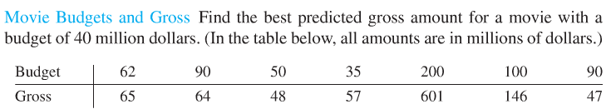
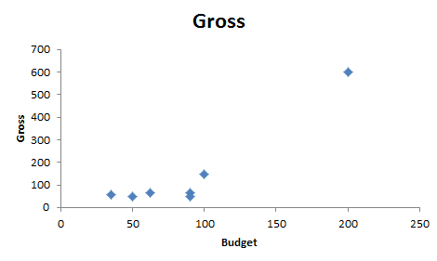
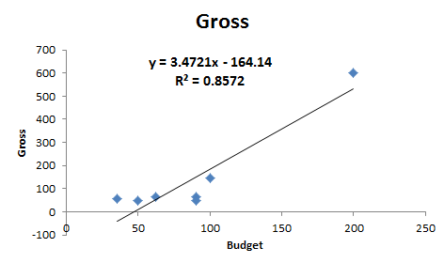
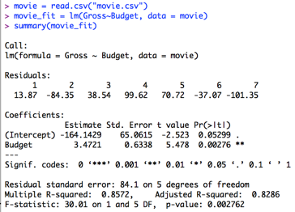
Movies!!!
1. Ho: $ρ=0$
Ha:$ρ≠0$
same as:
Ho: $β_{1}$ = 0
Ha: $β_{1}$ ≠ 0
2. CV = 2.57
3. t = 5.48
4. p-value
= .0028
6. There is sufficient evidence at the alpha = .05 level of significance (pval = .0028) to suggest that the data are linearly correlated. We will proceed to calculate the regression line.
Y
X
Linear model function
Gross = – 164.14 + 3.472 * Budget
“Parameter Estimate Table”
Equation of Regression Line:
beta0 = -164.14 beta1 = 3.4721

Slide 20
Movies!!!
Estimate ± t_{α/2,df}*SE
Estimate ± t_{α/2,df}*SE
df = n-2
df = n-2
Budget_slope ± t_{.025,5}*SE
Intercept ± t_{.025,5}*SE
3.472 ± 2.571*.6338
-164.143 ± 2.571*65.06
(1.84, 5.10)
(-331.39,3.103)
We are 95% confident that the when the budget is increased by $1 million dollars the mean gross increases between $1.84M and $5.10M
We are 95% confident that for a budget of 0, the mean gross is between $0 and $3.103 M

Slide 21
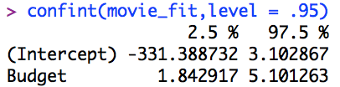
Movies!!!
Estimate ± t_{α/2,df}*SE
Estimate ± t_{α/2,df}*SE
df = n-2
df = n-2
Budget_slope ± t_{.025,5}*SE
Intercept ± t_{.025,5}*SE
3.472 ± 2.571*.6338
-164.143 ± 2.571*65.06
(1.84, 5.10)
(-331.39,3.103)
We are 95% confident that the when the budget is increased by $1 million dollars the mean gross increases between $1.84M and $5.10M
We are 95% confident that for a budget of 0, the mean gross is between $0 and $3.103 M
lm object

Slide 22
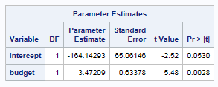
Movies Cont. !!!
Equation of Regression Line:
beta0 = -164.14 beta1 = 3.4721
Gross = – 164.14 + 3.472 * Budget
Interpret the Slope: It is estimated that for every increase in $1 million to the budget, the movie will gross $3.4721 million more. A 95% confidence interval is ($1.84 M, $5.10 M).
Interpret the y-int: For a movie with no budget ($0) it is predicted that is will gross $0 (-$164 million from regression equation.) A 95% confidence interval is ($0, $3.3 M).This has little practical meaning which is to be expected since it is extrapolation.

Slide 23
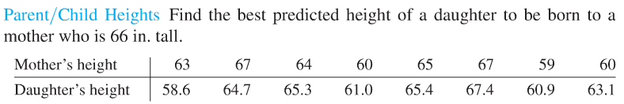
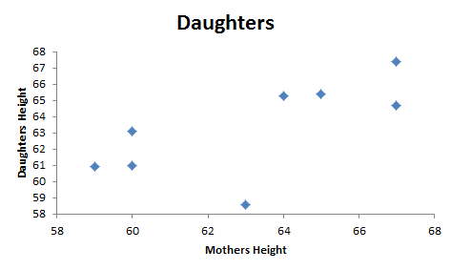
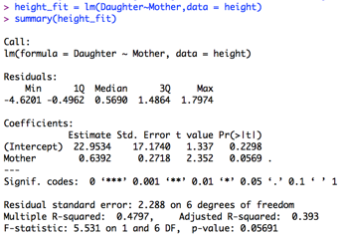
Parent/Child Heights
1. Ho: ρ = 0
Ha: ρ ≠ 0
same as:
Ho: $β_{1}$ = 0
Ha: $β_{1}$ ≠ 0
2. CV = 2.45
3. TS = 2.35
4. Pval = .0569
5. FTR Ho
6. There is not sufficient evidence at the alpha = .05 level of significance (pval = .0569) to suggest that the data are linearly correlated. The best predicted height of a daughter given the mothers height is the average of the daughters heights in the sample.
Best Predicted Value is the average height:
63.3 inches (from 1 var stats in calculator)

Slide 24
Parent/Child Heights
1. Ho: ρ = 0
Ha: ρ ≠ 0
same as:
Ho: $β_{1}$ = 0
Ha: $β_{1}$ ≠ 0
2. CV = 2.45
3. TS = 2.35
4. Pval = .0569
5. FTR Ho
6. There is not sufficient evidence at the alpha = .05 level of significance (pval = .0569) to suggest that the data are linearly correlated. The best predicted height of a daughter given the mothers height is the average of the daughters heights in the sample.
Estimate ± t_{α/2,df}*SE
df = n-2
Mother ± t_{.025,6}*SE
.63915 ± 2.447*.27176
(-.02585, 1.304)
Notice the interval contains zero which implies that no linear correlation (ρ = 0) is plausible given the data. The interval agrees with our hypothesis test!

Slide 25
Parent/Child Heights
Equation of Regression Line
Daughter = .639 * Mother + 22.95
Best Predicted Value is the average height:
63.3 inches A 95% confidence interval for the mean (not β₀) is (60.845,65.755) inches.
$$\overline{x}±t∗s/{\sqrt{n}}=63.3±2.365∗{2.936}/{\sqrt{8}}$$

Slide 26
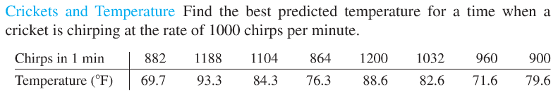
You Try It!
Plot the data and assess the visual evidence of a linear trend.
Conduct a hypothesis test for non zero correlation (rho). Like we did last time.
Conduct a hypothesis test for non zero intercept and slope. (Regress Y on X…. that is regress temperature on cricket chirps.)
Compare the pvalue between the test for correlation and the test for slope.
Use you regression line to predict the temperature when there are 1000 cricket chirps per minute.
Interpret the Slope and Intercept.

Slide 27
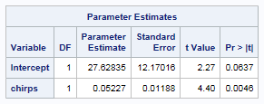
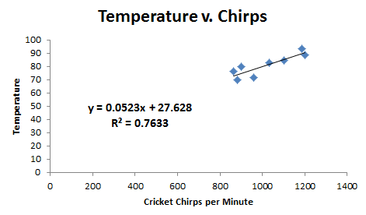
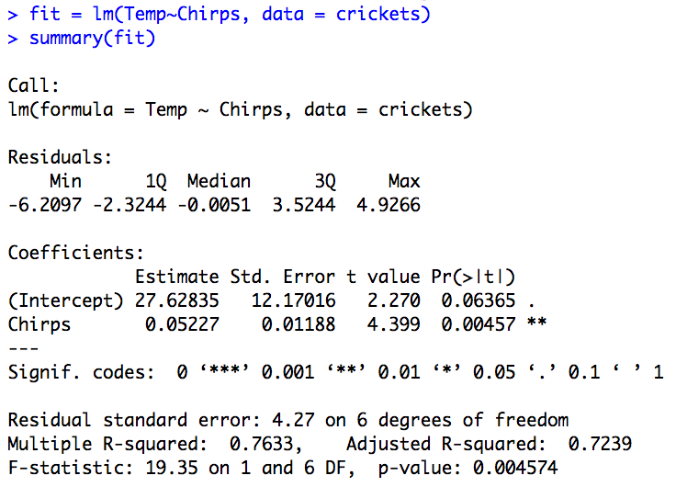
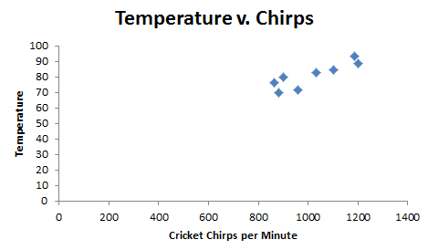
Crickets!!!
Reject Ho.
There is sufficient evidence at the alpha = .05 level of significance (pval = .0046) to suggest that the data are linearly correlated. We will proceed to calculate the regression line.
Equation of Regression Line
^
Temp =.0523 * Chirps + 27.63
Predicted temperature when a cricket is chirping 1000 times per minute:
y₁₀₀₀=.0523(1000) + 27.63 = 79.9 degrees F

Slide 28
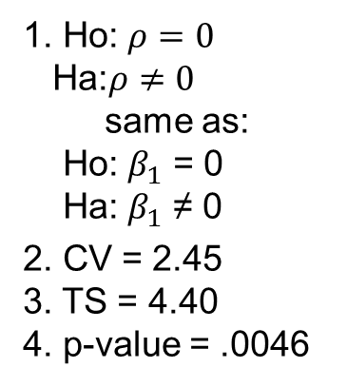
Crickets!!!
1. Ho: $ρ=0$
Ha:$ρ≠0$
same as:
Ho: $β_{1}$ = 0
Ha: $β_{1}$ ≠ 0
2. CV = 2.45
3. TS = 4.40
4. p-value = .0046
5. Reject Ho.
6. There is sufficient evidence at the alpha = .05 level of significance (pval = .0046) to suggest that the data are linearly correlated. We will proceed to calculate the regression line.
^
Equation of Regression Line
Temp =.0523 * Chirps + 27.63
Predicted temperature when a cricket is chirping 1000 times per minute:
y₁₀₀₀=.0523(1000) + 27.63 = 79.9 degrees F

Slide 29
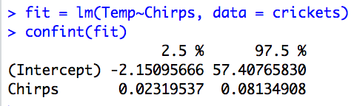
Crickets!!!
Equation of Regression Line
^
Temp =.0523 * Chirps + 27.63
Interpret the slope: For every increase in 1 chirp per minute the estimated temperature increases .0523 degrees F. We are 95% confident that this increase will be between .023 and .081 degrees.
Interpret the y-int: If there are no crickets chirping, the estimated temperature is 27.63 degrees F (95% CI: (-2.15, 57.41).
While this is extrapolation, it does have a practical interpretation.

Slide 30
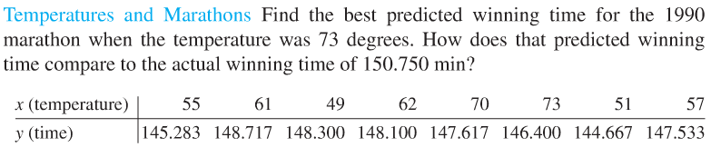
You Try It!
Plot the data and assess the visual evidence of a linear trend.
Conduct a hypothesis test for non zero correlation (rho). Like we did last time.
Conduct a hypothesis test for non zero intercept and slope. (Regress Y on X…. time on temperature.)
Compare the pvalue between the test for correlation and the test for slope.
Use you regression line to predict the time to complete the marathon when the temperature is 65 degrees. Do it again for 59 degrees.
Interpret the Slope and Intercept.

Slide 31
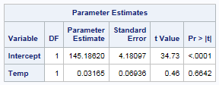
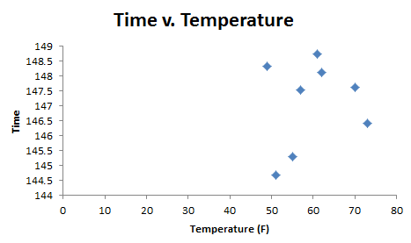
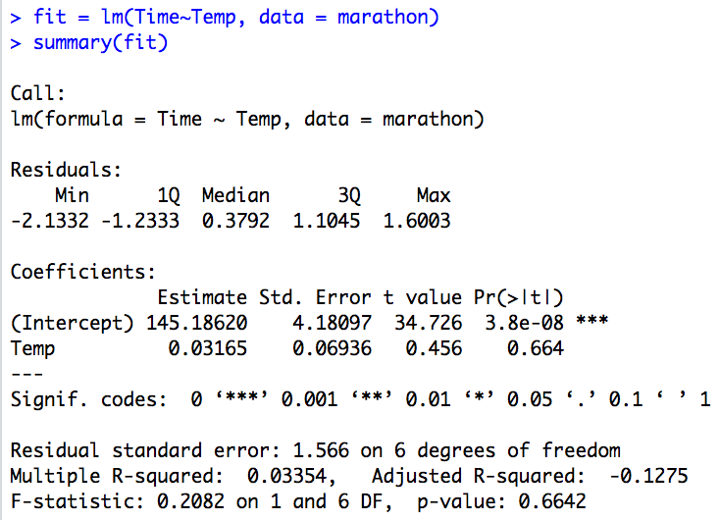
Marathons!!!
6. There is not sufficient evidence at the alpha = .05 level of significance (pval = .6642) to suggest that the data are linearly correlated. The best predicted finishing time given temperature is the average of all the finishing times in the sample.
Best Predicted Value is the average time: 147.077 sec.

Slide 32
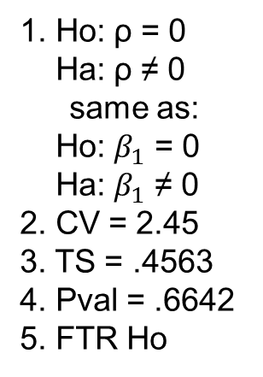
Marathons!!!
1. Ho: ρ = 0
Ha: ρ ≠ 0
same as:
Ho: $β_{1}$ = 0
Ha: $β_{1}$ ≠ 0
2. CV = 2.45
3. TS = .4563
4. Pval = .6642
5. FTR Ho
6. There is not sufficient evidence at the alpha = .05 level of significance (pval = .6642) to suggest that the data are linearly correlated. The best predicted finishing time given temperature is the average of all the finishing times in the sample.
Best Predicted Value is the average time: 147.077 sec.

